Slide 1
PREDICTIVE ANALYSIS
HASHINI 18PD11
JANANI 18PD12
VARSHA 18PD39
PARKINSON’S DISEASE DIAGNOSIS USING GAIT VARIABLES

Slide 2
CONTENTS
Stating the problem
Objective
Dataset description
Methodology
Results and discussions
Bibliography

Slide 3
PROBLEM STATEMENT
Parkinson’s disease (PD) is a cognitive degenerative disorder of the central nervous system that mainly affects the motor system. The earliest symptoms evidence a general deficit of coordination and an unsteady gait. Current approaches for the evaluation and assessment of gait disturbances in PD have proved to be expensive, inconvenient and ineffective in the detection of anomalous walking patterns.In this project , we address these issues by designing a predictive analytic model for the detection of anomalous walking patterns in the gait dynamics of elderly people by analyzing the acceleration values of their movements. The results show a training accuracy and testing accuracy of over 90% with an accuracy improvement of 4.28% in comparison with related works.

Slide 4
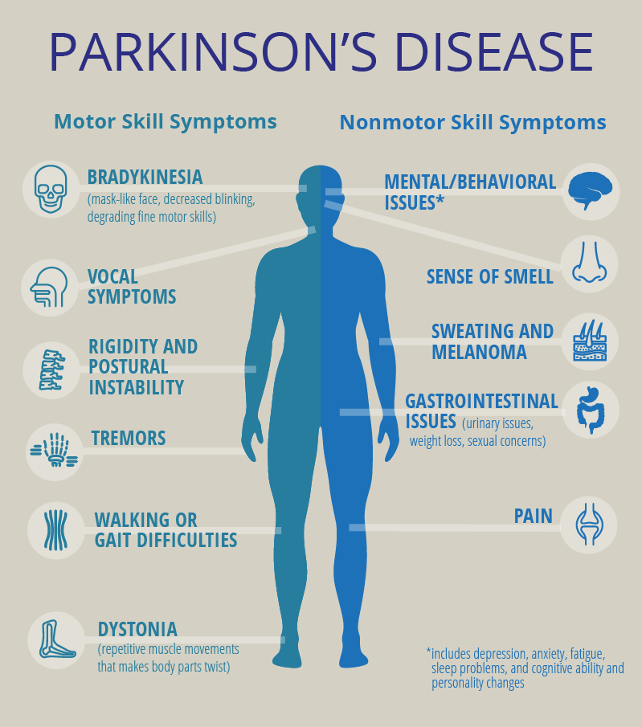
OBJECTIVE
To classify subjects into either healthy or parkinsonian classes using various classification methods such as K-NN ( K nearest neighbours) , K means , SVM (support vector machines) , random forest and decision tree algorithms .

Slide 5
DATASET DESCRIPTION
This database contains measures of gait from 93 patients with idiopathic PD (mean age: 66.3 years; 63% men), and 73 healthy controls (mean age: 66.3 years; 55% men). The database includes the vertical ground reaction force records of subjects as they walked at their usual, self-selected pace for approximately 2 minutes on level ground. Underneath each foot were 8 sensors that measure force (in Newtons) as a function of time. The output of each of these 16 sensors has been digitized and recorded at 100 samples per second, and the records also include two signals that reflect the sum of the 8 sensor outputs for each foot.

Slide 6
DATA-SET
Below is our GAIT variable dataset,taken from https://physionet.org/content/gaitpdb/1.0.0/
https://drive.google.com/open?id=1GGQeBwTSKVQx1a-nQT81i2Q0JfEDy7PE

Slide 7
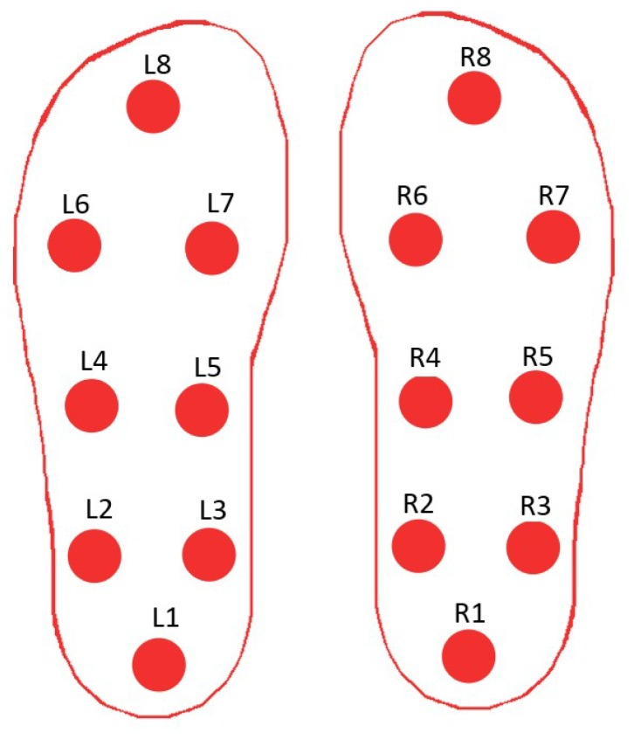
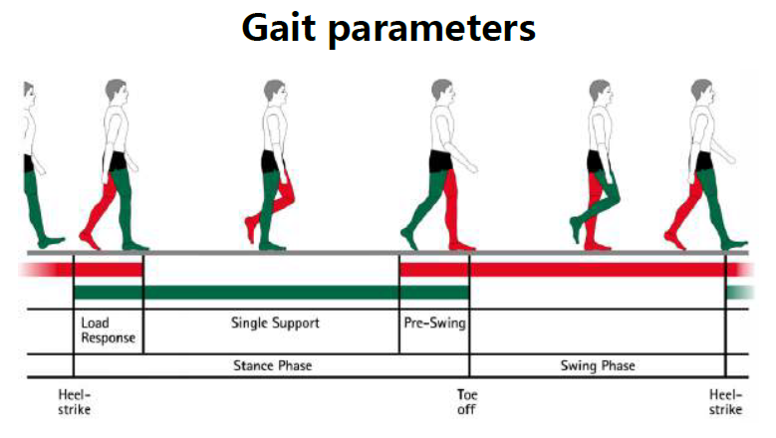
There are many companies that produce these sensors to measure gait variables one such is made by RunScribe which is an online platform which measures gait variables using sensors and keeps track of the patient's gait activities in their app , it costs around $400.

Slide 8
The dataset includes the following attributes
Group : whether the person has PD or not
Subject number
Gender
Age
Height in meters
Weight in kilograms
Hoehn-Yahr scale : commonly used system for describing how the symptoms of Parkinson's disease progress
UPDRS : Unified Parkinson’s Disease Rating Scale to evaluate various aspects of Parkinson’s disease including non-motor and motor experiences of daily living and motor complications.

Slide 9
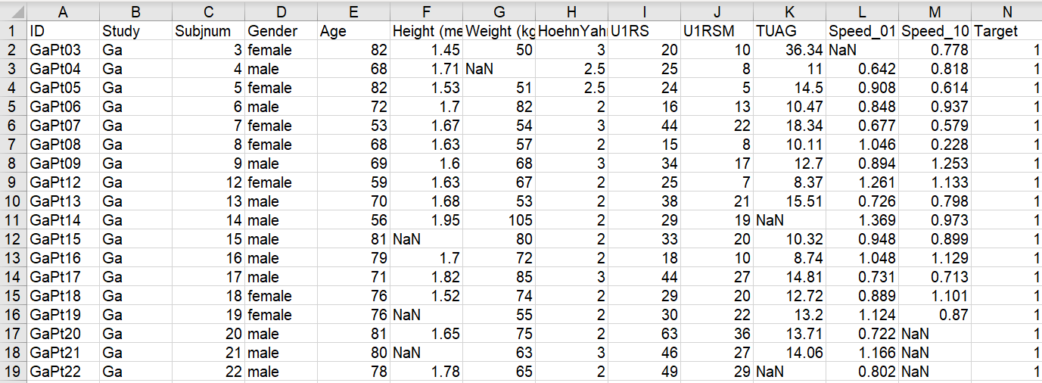
9. TUAG : time up and go is a simple measure of mobility
10. Speed_01 (m/sec) : speed maintained to walk 1 meter
11. Speed_10 (m/sec) : speed maintained to walk 10 meter

Slide 10
Methodology
Feature extraction
Feature selection
Decision tree
Random forest
KNN classifier
K mean clustering
SVG method
*Hyperlinks to that particular topic is included
*kindly open the links in google colaboratory.

Slide 11
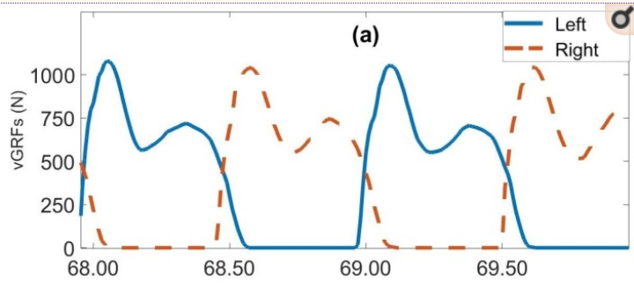
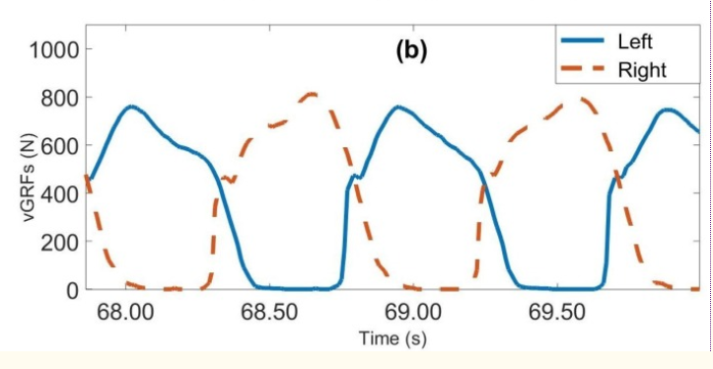
vGRFs measured on left foot (blue) and right foot (red); (a) healthy subject, (b) subject with PD.

Slide 12
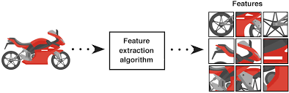
FEATURE EXTRACTION:
In this study, the most relevant spatiotemporal features from the clinical point of view are extracted from vGRF signals. A total of nineteen features were extracted.
A few of them are Coefficients of Variations in percentage (%) of Swing Time of the left,coefficient of Variations in duration (s) of the Stride Time of the left,coefficient of Variation of the Gait Asymmetry,mean in percentage (%)of the Swing Time of the left foot ,mean of the Short Swing Time etc..

Slide 13
FEATURE SELECTION:
Feature selection is an important step before applying classification algorithms because it improves the overall classification performances and reduces the complexity and computation time of the algorithms. To achieve accurate classification results, using more than one feature is common. However, increasing the number of features may lead to the so-called curse of dimensionality, which results in a degraded classifier performance and increases the computation time and model complexity.
Feature selection can be done in three steps:
Generation of a subset of features by different strategies.
Evaluation of generated subset using various evaluation models.
Halting the feature selection using specific terminating conditions.

Slide 14
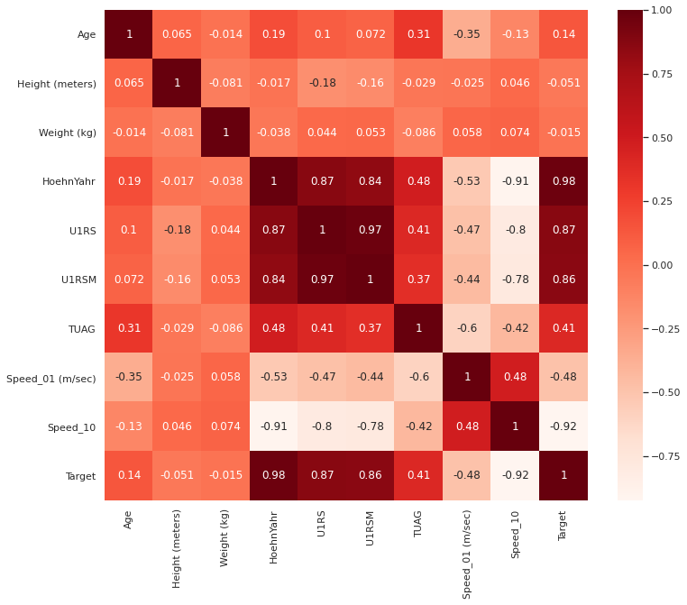
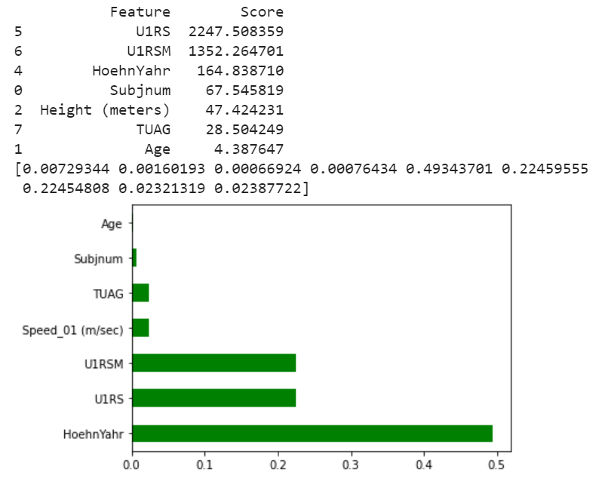
Feature Selection.ipynb
We have selected 7 features from the given dataset using the Feature Selection methods.
OUTPUT:

Slide 15
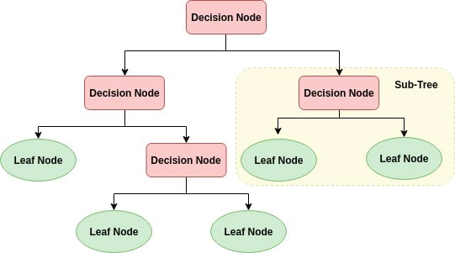
Decision tree
A decision tree is a flowchart-like tree structure where an internal node represents feature(or attribute), the branch represents a decision rule, and each leaf node represents the outcome. The top-most node in a decision tree is known as the root node. It learns to partition on the basis of the attribute value. It partitions the tree in recursive manner calling the recursive partitioning method . This flowchart-like structure helps you in decision making. It's visualization like a flowchart diagram which easily mimics the human level thinking. That is why decision trees are easy to understand and interpret.

Slide 16
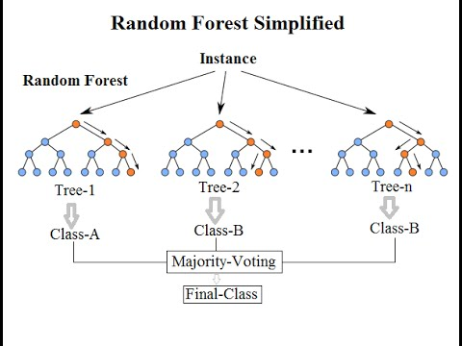
RANDOM FOREST CLASSIFIER
Random forests is a supervised learning algorithm. It can be used both for classification and regression. It is also the most flexible and easy to use algorithm. A forest is comprised of trees. It is said that the more trees it has, the more robust a forest is. Random forests creates decision trees on randomly selected data samples, gets prediction from each tree and selects the best solution by means of voting. It also provides a pretty good indicator of the feature importance.

Slide 17

Support vector machine(svm)
The support vector machine is a well-known supervised machine learning model that is used primarily for binary prediction problems. The underlying idea of this model is based on the concepts of a hyperplane and the margin. The learning process consists of finding a linear separator (also called a hyperplane) which separates the training data while maximizing the margin between the hyperplane and these training data.

Slide 18
K-NN Clustering
K-nearest neighbour is one of the simplest supervised classification approaches. It is a non-parametric supervised classification method.
In K-NN, no explicit or modelling phase occurs before the classification phase. Classification with K-NN involves two main steps:
(1) a distance calculation (usually, Euclidean distance) is made between the new sample and all training samples;
(2) the new sample is assigned to the majority class of the nearest samples using the K nearest neighbour selection.

Slide 19
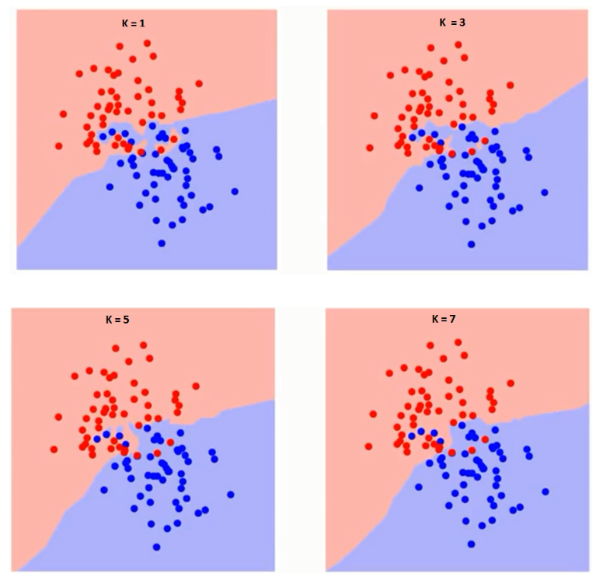
If we watch carefully, you can see that the boundary becomes smoother with increasing value of K.
With K increasing to infinity it finally becomes all blue or all red depending on the total majority.

Slide 20
K-means clustering
K-means is still another simple unsupervised machine learning model.
This method divides the training data into k homogeneous clusters .
The objective is to minimize the total intra-cluster variance and the distortion measure as a cost function.
The K-means model finds the cluster centroids iteratively and assigns the data to the various cluster centroids based on their distance (e.g., Euclidean) until convergence occurs.

Slide 21
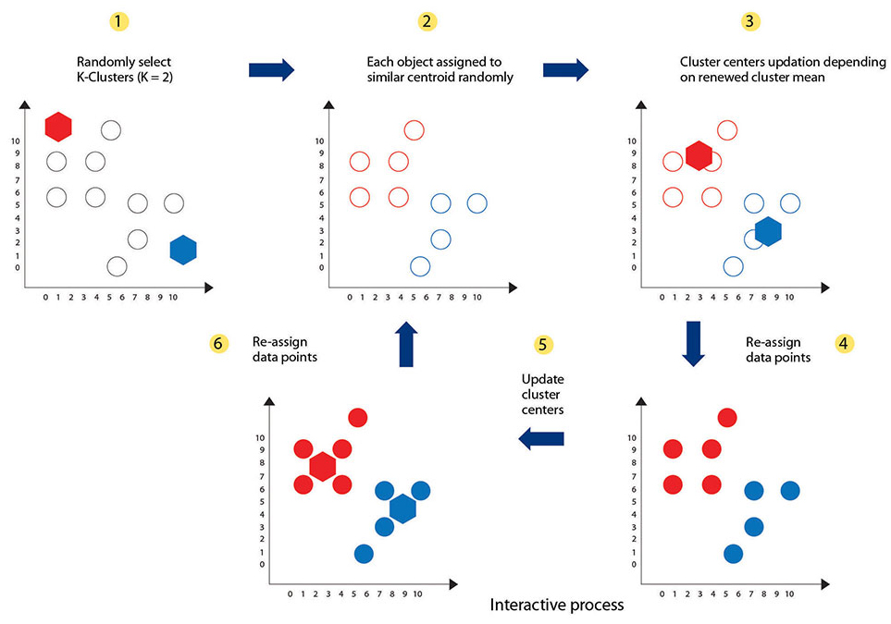

Slide 22
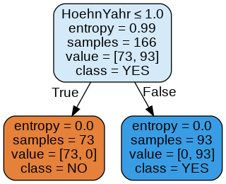
STATISTICAL ANALYSIS & RESULTS
Decision tree :
https://drive.google.com/open?id=1rONHJzO2PRznjKUerhtcJJ3CvUpaHuMJ
Output:
Inference :
If the Hoehn Yahr scale rating is less than or equal to 1 then the subject may have Parkinson disease.

Slide 23
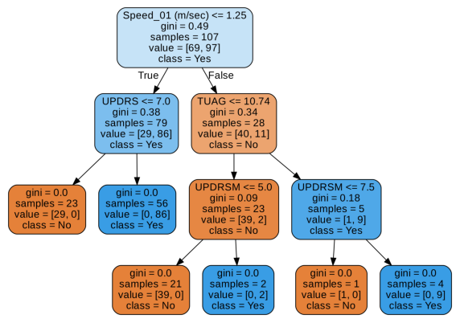
Random forest classifier: https://drive.google.com/open?id=1jW8pSOcOs7i4OesdyOFdnE5bnl07oxd5
Output:

Slide 24
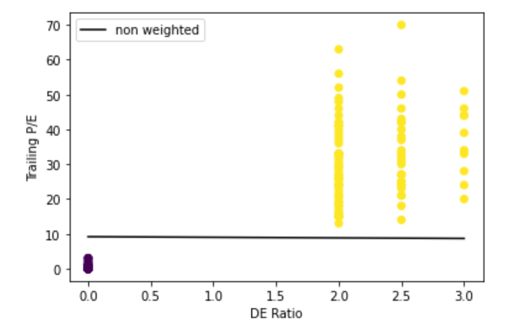
Support Vector Machine Classifier:
https://drive.google.com/open?id=1EoiAM3kvHoW7uq64SR0aM_RcZRIlzSUp
OUTPUT:

Slide 25
PSEUDO CODE OF KNN:-
We can implement a KNN model by following the below steps:
Load the data
Initialise the value of k
For getting the predicted class, iterate from 1 to total number of training data points
Calculate the distance between test data and each row of training data. Here we will use Euclidean distance as our distance metric since it’s the most popular method. The other metrics that can be used are Chebyshev, cosine, etc.
Sort the calculated distances in ascending order based on distance values
Get top k rows from the sorted array
Get the most frequent class of these rows
Return the predicted class

Slide 26
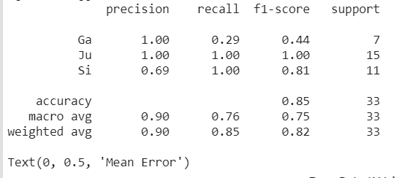
Check out this link for the implementation of KNN clustering in Python.
https://drive.google.com/open?id=1n5IRYFeT3z2kAy0tl5pMk9Bo0Oinb-gZ
OUTPUT:

Slide 27
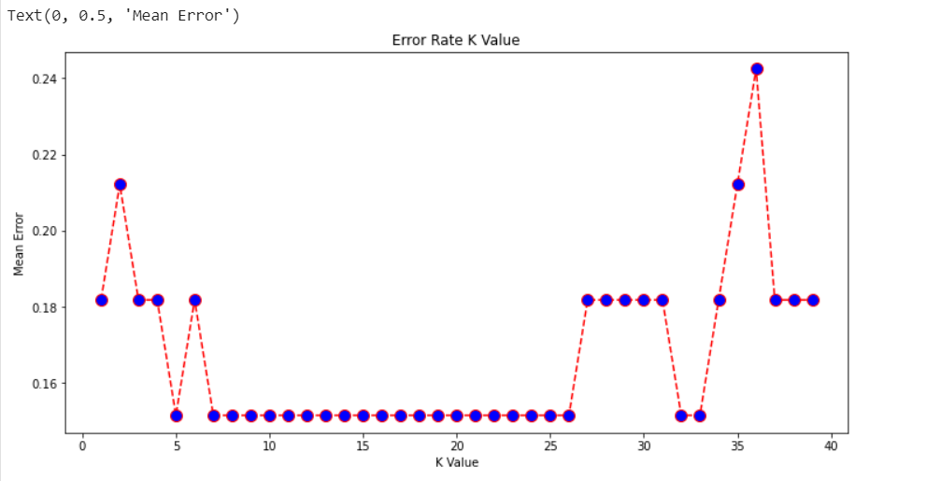

Slide 28
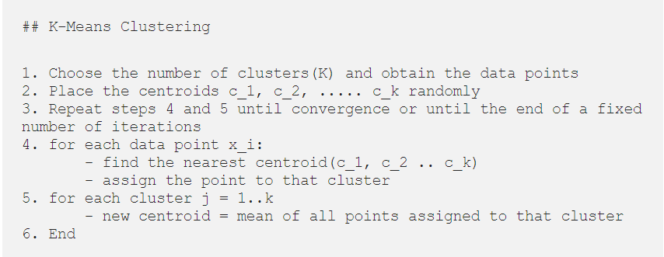
PSEUDO-CODE FOR K MEANS

Slide 29
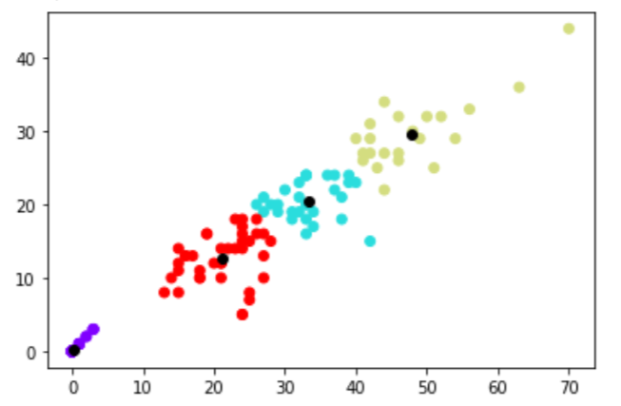
Check out this link for the implementation of KNN clustering in Python.
https://drive.google.com/open?id=1zio8C1D_cymM2mNR8vdWU2i3fecJI7Rn

Slide 30
Results and discussions
The classification techniques described above were implemented to classify subjects with PD. Five supervised classification techniques, namely, K-nearest neighbour (K-NN), SVM, Decision tree,and Random Forest , as well as an unsupervised technique, the K-means, were compared using standard evaluation metrics. The inputs to both the supervised and unsupervised approaches are the extracted and selected features from the raw data.

Slide 31
bibliography
G. Paragliola and A. Coronato, "Gait Anomaly Detection of Subjects With Parkinson’s Disease Using a Deep Time Series-Based Approach," in IEEE Access, vol. 6, pp. 73280-73292, 2018.
Perlmutter, Joel S. “Assessment of Parkinson disease manifestations.” Current protocols in neuroscience vol. Chapter 10 (2009): Unit10.1. doi:10.1002/0471142301.ns1001s49
Khoury, Nicolas et al. “Data-Driven Based Approach to Aid Parkinson's Disease Diagnosis.” Sensors (Basel, Switzerland) vol. 19,2 242. 10 Jan. 2019, doi:10.3390/s19020242
https://www.ncbi.nlm.nih.gov/pmc/articles/PMC6359125/

